Slide 1
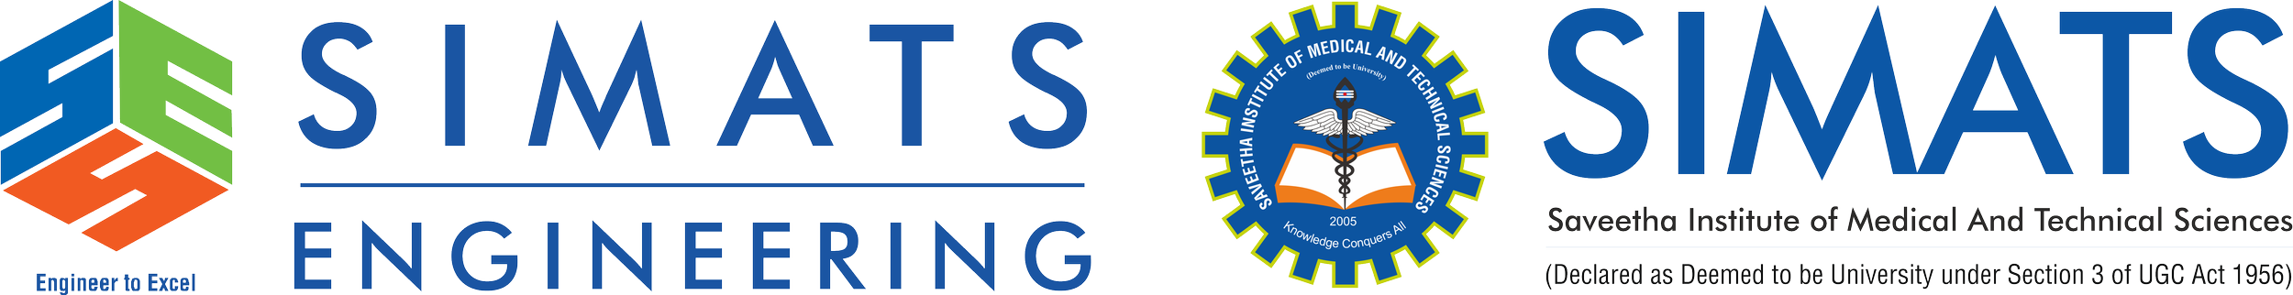
GestureTalk AI
An Intelligent and Adaptive Indian Sign Language Recognition and Communication System
A multimodal approach to accessible communication
Presented by: R.MOHANRAM
Reg.no: 192521117
Department: B.tech IT

Slide 2
Problem Statement
THE COMMUNICATION CHALLENGE
HAND SIGNS
NON-MANUAL CUES
Communication can be difficult when a signer and a non-signer do not share a common language. Sign meaning can depend on hand movement, facial cues, body posture and sequence context.
Hand shape, orientation, location and movement.
Facial expression and body posture can contribute meaning.
PROJECT AIM
Develop an intelligent system to recognize selected ISL signs and support communication between signers and non-signers.
Design focus: accessibility • context • confidence-aware output

Slide 3
Proposed System & Objectives
Full project vision and current implementation are shown separately
1. CAPTURE
2. TRACK
3. INTERPRET
4.COMMUNICATE
5. SUPPORT
Camera video
→
Hands, face and body
→
Motion + sequence context
→
Text / speech output
→
Uncertainty feedback
CURRENT WORKING PROTOTYPE
PLANNED FULL-SYSTEM CAPABILITIES
• Static hand-sign classification for A–H
• 82-feature representation from hand landmarks and geometry
• Temporal smoothing and an unknown-sign rejection mechanism
• Expand to a broader ISL vocabulary and dynamic signs
• Add facial and body cues with temporal modelling
• Add text/speech-to-sign support and learning features

Slide 4
Methodology & Technology
Current pipeline plus planned multimodal extension
01 • DATA
02 • HAND LANDMARKS
03 • FEATURES
1,200 labeled samples
A–H, 150 samples per class
MediaPipe Tasks tracks 21 hand landmarks: 63 coordinate values.
63 coordinates + 19 geometric features = 82 values.
04 • CLASSIFIER
05 • STABILITY
06 • NEXT EXTENSION
Random Forest with 300 estimators.
Temporal voting reduces rapid frame-to-frame label changes.
Add face/body landmarks and dynamic sequence modelling.
Current tools: Python • OpenCV • MediaPipe Tasks • NumPy • scikit-learn • joblib
Face/body tracking and multimodal fusion are planned, not claimed as implemented.

Slide 5
Future Work & Conclusion
Building toward broader, context-aware ISL recognition
PHASE 1 • VALIDATE
PHASE 2 • MULTIMODAL
PHASE 3 • COMMUNICATION
Test on separate sessions and unfamiliar hand shapes; calibrate rejection.
Collect data for dynamic signs and integrate hand, face and body cues.
Build text/speech input, verified sign output and learning support.
EXPECTED IMPACT
CONCLUSION
A more accessible interface for communication using selected Indian Sign Language signs.
The current milestone is live A–H hand-sign recognition. The long-term goal is a reliable, multimodal ISL communication assistant.
Thank you

